Slide 1


Slide 2

Excel 2016

Slide 3
Introduction to Excel functions
Pivot Table a table for further analysis of your data
Vlookup Function a function to find unknown value
Statistical Functions mode, median, average (mean)
Logistical Function the ‘IF’ function

Slide 4

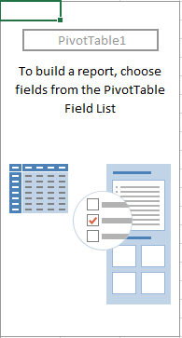
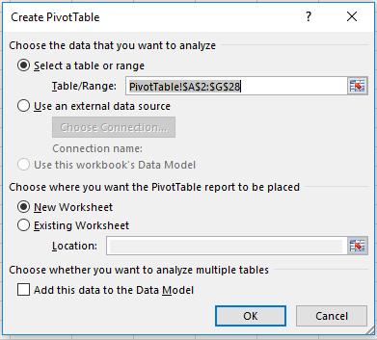
Introduction to Excel functions
Pivot Table a table for further analysis of your data
Vlookup Function a function to find unknown value
Statistical Functions mode, median, mean
Logistical Function the ‘IF’ function

Slide 5
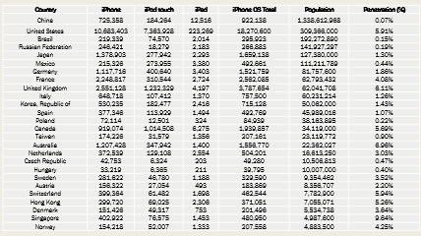
Oct 2010 sale figure of Apple Inc
26 rows
7 columns country, iPhone, iPod touch, iPad, iPhone OS total, population, % penetration

Slide 6
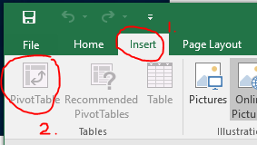
1. Pivot Table (PT)
What is PT? > PT is a table for further analysis.
What can you do with PT? > You could sort, filter, sum, count, and many other functions. Please see demo.
How to do it in excel 2016? In Excel 2016,
Select your table using your mouse cursor.
Go to Insert Tab > Pivot Table

Slide 7
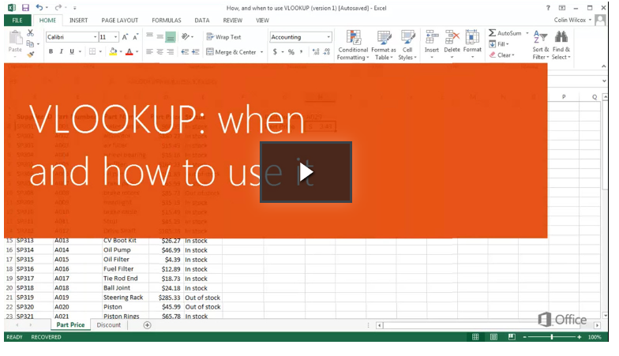
Introduction to Excel functions
Pivot Table a table for further analysis of your data
Vlookup Function a function to find unknown value
Statistical Functions mode, median, mean
Logistical Function the ‘IF’ function

Slide 8
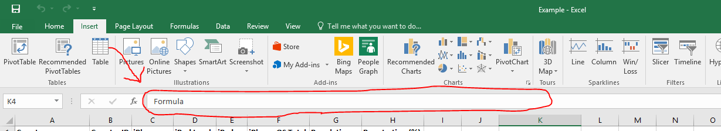
2. Vlookup function(VF)
What is VF? > Vlookup function is a value lookup function.
Example 1: Using NRIC (known) to find the monthly contribute of a person’s CPF account(unknown).
Example 2: Using the country id (known or given) to find the sales of iPad
What can you do with VF? > When given a lookup value, you can find an unknown value.
How to do it in excel 2016? In Excel 2016,
Go to formula bar
Type =VLOOKUP( value, table, index_number, [approximate_match] )

Slide 9
2. Vlookup Syntax
=VLOOKUP( value, table, index_number, [approximate_match] )
value
The value to search for in the first column of the table.
table
Two or more columns of data that is sorted in ascending order.
index_number
The column number in table from which the matching value must be returned. The first column is 1.
approximate_match
Optional. Enter FALSE to find an exact match. Enter TRUE to find an approximate match. If this parameter is omitted, TRUE is the default.

Slide 10
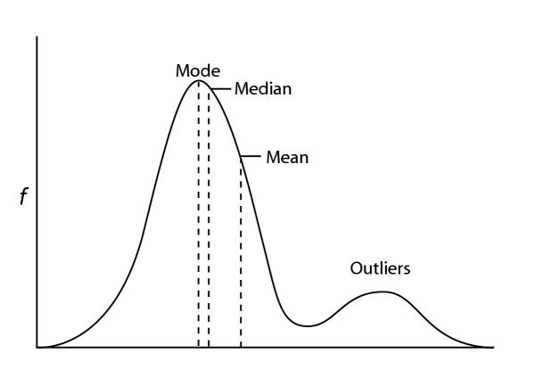
Introduction to Excel functions
Pivot Table a table for further analysis of your data
Vlookup Function a function to find unknown value
Statistical Functions mode, median, average (mean)
Logistical Function the ‘IF’ function

Slide 11
3. Statistical functions (Average, Mode, Median)
What are the syntax for average, mode and median? .
=average(number1, [number2, …. Number n])
=mode(number1, [number2, …. Number n])
=median(number1, [number2, …. Number n])
Define Average, Mode, Median: > Average is the arithmetic mean. > Mode is value that appears most in a set. (most frequently occurring number) > Median is the middle value of a sorted set.
How to do it in excel 2016? In Excel 2016,
Go to formula bar
Type the specific formula eg. =average(B3:B12)

Slide 12
3. Statistical Syntax for Average, Mode, Median
=average(number1, [number2, …. Number n])
=mode(number1, [number2, …. Number n])
=median(number1, [number2, …. Number n])
number1, number2, ... Number_n
Numeric values that can be numbers, named ranges, arrays, or references to numbers. There can be up to 30 values entered.

Slide 13
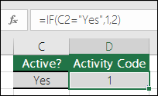
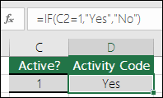
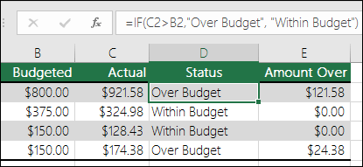
Introduction to Excel functions
Pivot Table a table for further analysis of your data
Vlookup Function a function to find unknown value
Statistical Functions mode, median, mean
Logistical Function the ‘IF’ function

Slide 14
4. IF function (logistical function)
What is IF function? > IF function allows you to set a condition and trigger a value.
Examples:
SYNTAX: ﻿﻿ IF(Something is True, then do this, otherwise do this)
Example: =IF(A1<B1,"OK",0)
EXPLANATION: If the value in A1 is less than the value in B1, the value "OK" is returned, otherwise return a 0.
How to do it in excel 2016? In Excel 2016,
Go to formula bar
Type =IF( condition, [value_if_true], [value_if_false] )

Slide 15
4. IF Syntax
=IF( condition, [value_if_true], [value_if_false] )
condition
The value that you want to test. Eg. B3 > A1 , B5 = A2
value_if_true
Optional. It is the value that is returned if condition evaluates to TRUE.
value_if_false
Optional. It is the value that is return if condition evaluates to FALSE.

Slide 16
Questions?
I am using excel 2016 on Window for this demonstration.
All questions can be sent to ytbryan@u.nus.edu.
All slides, data, excel can be found and downloadable on my github http://github.com/ytbryan/nyp

